Slide 1
SFP Demo Configuration Handbook WxCC 2.0
CCBU Solution Assurance
Document version 1.0
12-9-2020

Slide 2
What is this about ?
What is this Not about ?
Anyone with a WxCC 2.0 tenant access should be able to configure it to demonstrate the capabilities of this platform in their own demo/Gold tenants.
This handbook will be shared internally first (TME, TSA, Sales, Mktg) and eventually to partners in EFT
This is a ‘living document’, more capabilities will be added as they become available
This helps provide a consistent demo experience
Please glance over once to get the over-view. This is not super detailed, we assume you have most of the basic steps needed….
Training/Deep dive session
Step by Step demo guide/story with speaker notes (Will be a separate effort)

Slide 3
Overall Pre-Requisites / Assumptions
1 | Steps in this guide are based on and for configuring a tenant in production environment
2 | Users of this guide already have administrator access to a production tenant
3 | Voice connectivity is available on the production tenant
4 | DN to EP mapping is done with a working DN
5 | Users of this guide already have Email ID for email contact routing
6 | Users of this guide already have a SMS Number procured from MessageBird, that can be integrated with the tenant.
7 | Users of this guide already have a Facebook page which can be integrated with the tenant
8 | Users of this guide already have a Google CCAI account that can be configured in the tenant
9 | Tenant has Feature Flags enabled for desktop layout, Chat/Email, Virtual Assistant, Social, FlowControl
10 | All config entities are created with prefix MediAssist For example: Site: MediAssist_Site, Team: MediAssist_Team, EP: MediAssist_Voice_EP

Slide 4
Config Handbook - Who & Where ?
Module-1 | User Onboarding | Ankit
Module-2 | Chat | Abhishek
Module-3 | Email | Naveen
Module-4 | Social | Chandra
Module-5 | Voice | Avinash
Module-6 | WxM Post Call Survey | Raghu
Module-7 | External DB Dips | Chandramouli
Module-8 | Agent Desktop(KAD) | Sameer
 | Support/Facilitator | Gagarin
 | Reviewers/Mentors | Karthik/Mudit
Environment | ProdUS1 (WxCC US DC)
Org | Webex CC Demo 101
Org ID | 12700722-cd25-46b9-971e-ed0ce9f140c6
Access | <cec>@email.carehybrid.com
Control Hub | https://admin.webex.com
Portal | https://portal.wxcc-us1.cisco.com/portal/home.html
Agent Desktop | https://desktop.wxcc-us1.cisco.com
Main IVR | 516-517-9009
Sample API for Ext. DB Dip | https://5f9a64f59d94640016f709bf.mockapi.io/api/customers/account

Slide 5
Objective: You will be able to create/onboard new users and enable Contact Centre capabilities after which a new user will be able to login to the agent desktop and access all other admin modules within the WxCC.
Pre-Requisites/Assumptions
Outcome
Pre-Req/Assumption | Comments
Org is already created in ProdUS1
User is admin in the org
Email ID for new user(s) to be onboarded is created
The guide is for creating 1 user. You can create as many as you want if additional users are needed.
Outcome | Comments
New users should be ‘Active’ in control hub and also be replicated in WxCC portal
New user created should be able to login to agent desktop
New user should have ability to handled all contact types – voice, email | Chat ns social coming on next modules

Slide 6
Objective: This lab is designed to ensure we onboard various user personas in to WxCC.
As part of this guide, we will cover following steps:
Important: Let's use a naming convention in order to help us maintain this tenant. Please use the format from below. Most important, always lead with you username.
Voice Configuration:
Create EP = <username>_voice_EP ie: (ntheolog_voice_entrypoint)
Map DiD to your EntryPoint.
Create your Team = <username>_team
Create Q = <username>_voice_Q
Create EP Routing Strategies = <username>_RS_voice_EP
Create Q Routing Strategies = <username>_RS_voice_Q
Associate Teams to respective Q

Slide 7
Module 2
User Onboarding

Slide 8
Summary – The objective for this Module is to demonstrate the manual user onboarding on the Cisco Control Hub.
Control Hub Onboarding
Create Users
Activate Users (Agent / Supervisor)
Assign WxCC licenses
Modify the Roles of the Existing users
Synchronise the user from Control Hub to Cisco Webex CC Portal
Enabled the Contact centre feature from WebEx CC Portal
Assign the sample configurations to the newly added users (Agents)
Agent Login on the Agent Desktop

Slide 9
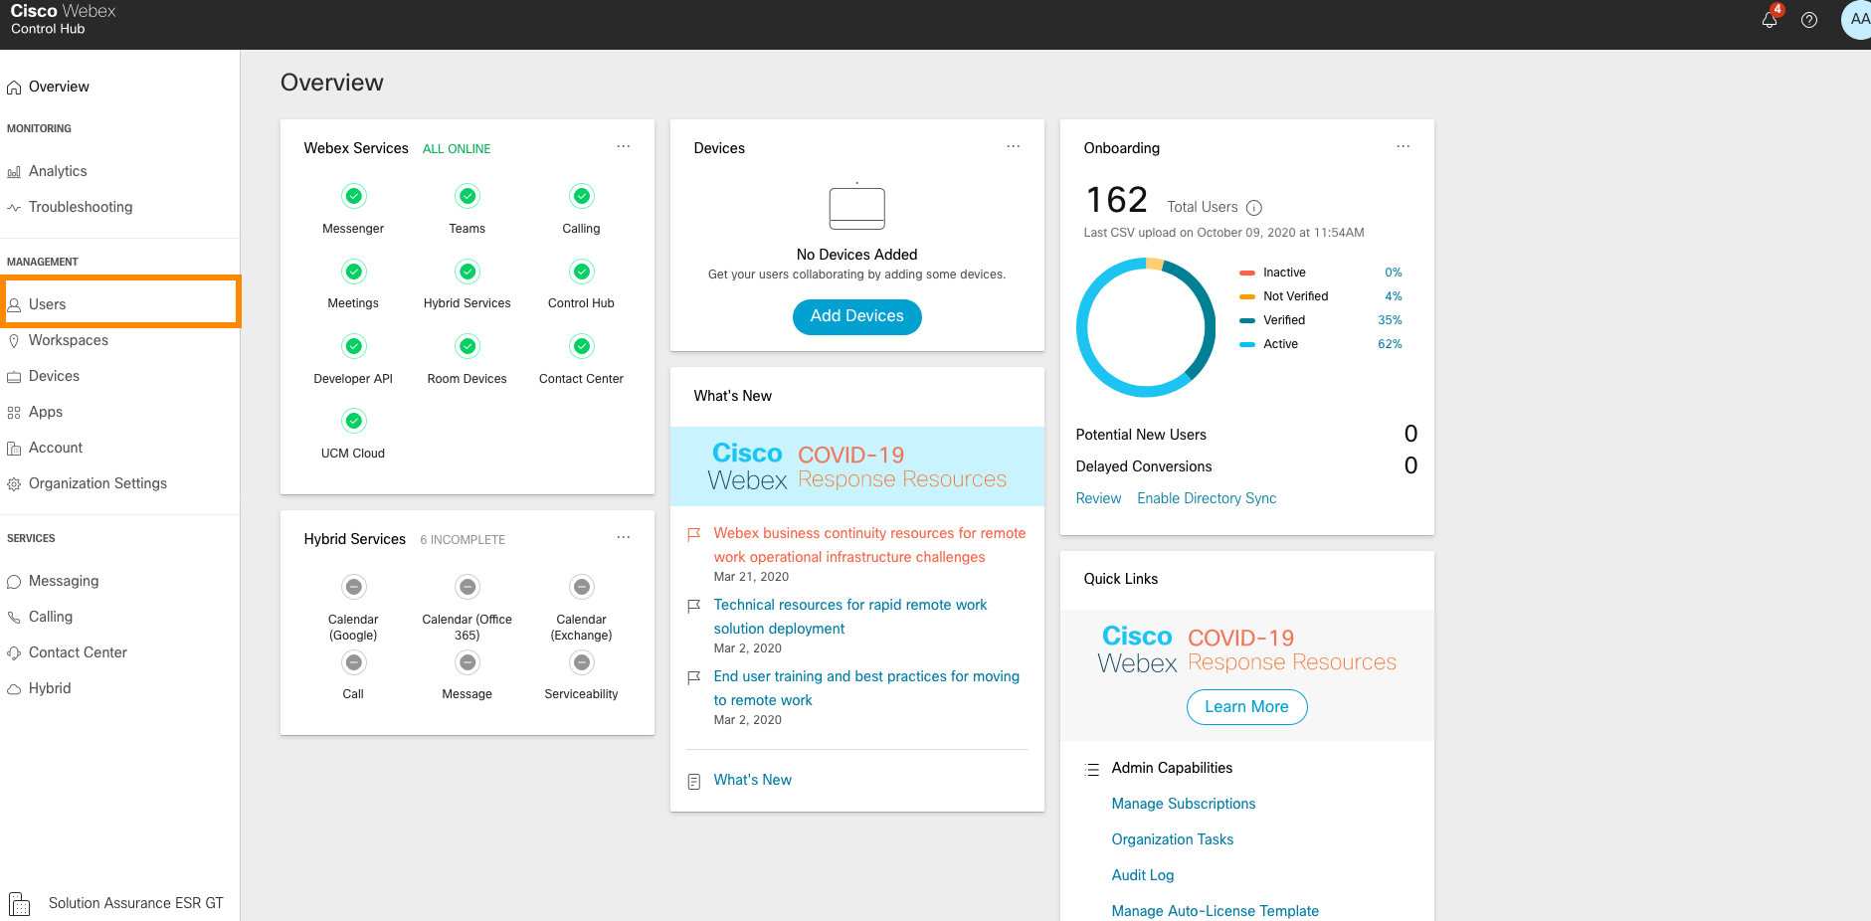
Step1: login to the Control Hub as an administrator by accessing (admin.webex.com) and navigate to the Users Tab.

Slide 10
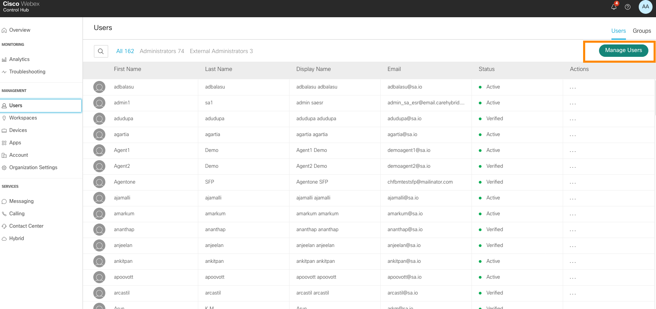
Step2: Click on Manage Users option to add the users Manually.

Slide 11
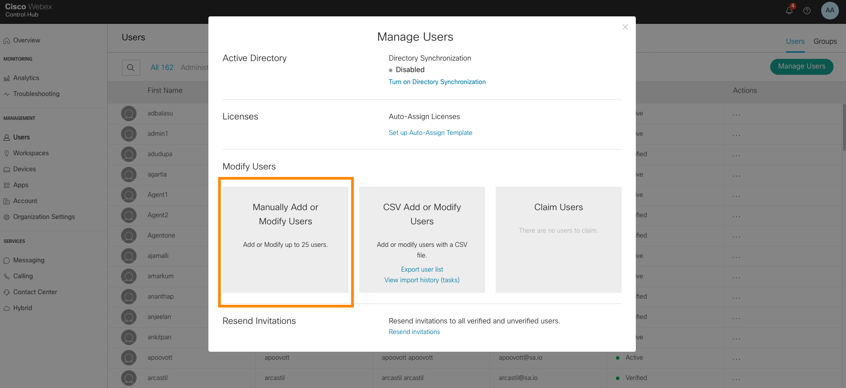
Step3: Click on Manually Add or Modify Users.

Slide 12
NOTE:
We have created an additional alias agent for everyone. This is the agent you will be on-boarding
User Alias:
<username>_agent1@email.carehybrid.com / ie: ntheolog_agent1@email.carehybrid.com
example

Slide 13
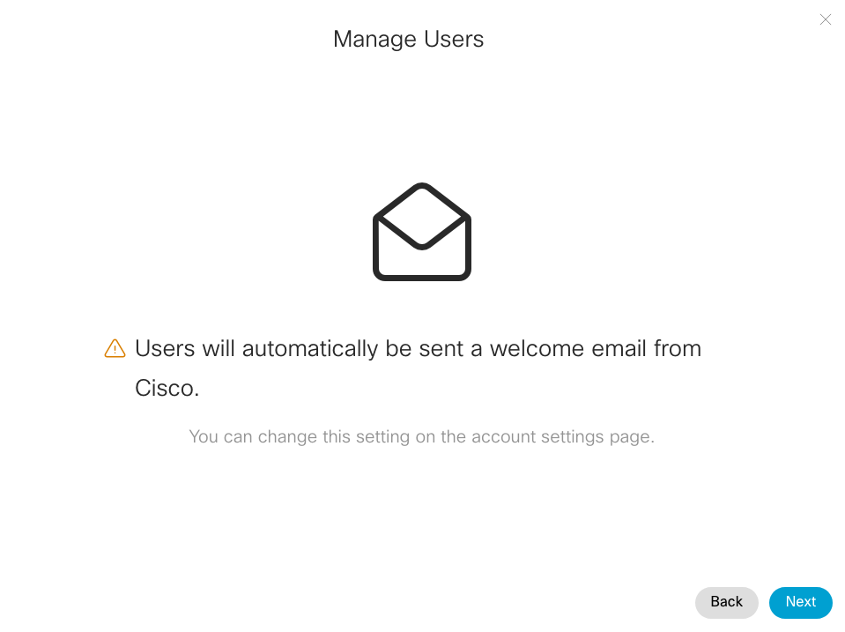
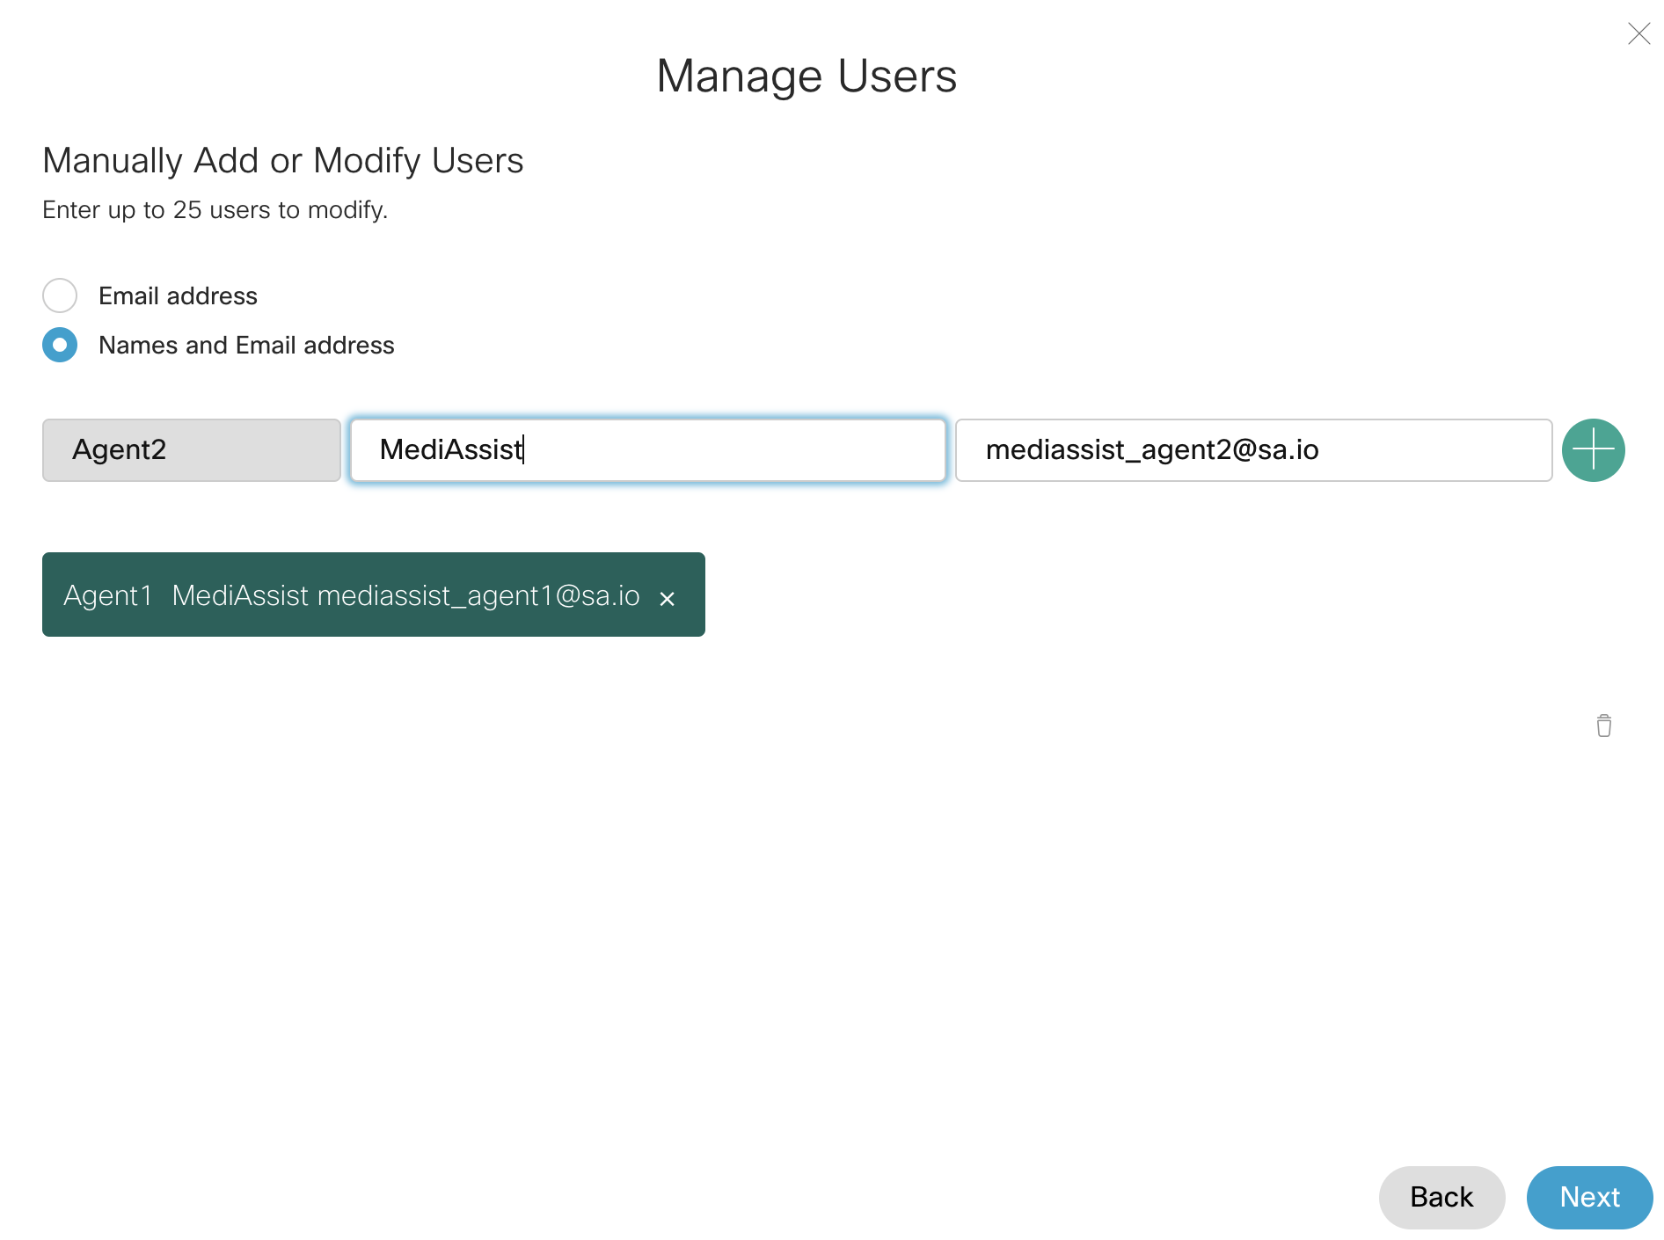
Step4: Administrator will get a Pop-up for Welcome Email Notification and once they click next the option will be presented to Add user manually. Up to 25 users can be added manually as shown below.
*Choose the second radio button option (Name and Email Address) Up to you as far as names…..but the email will be your <username>_agent1@email.carehybrid.com
example

Slide 14
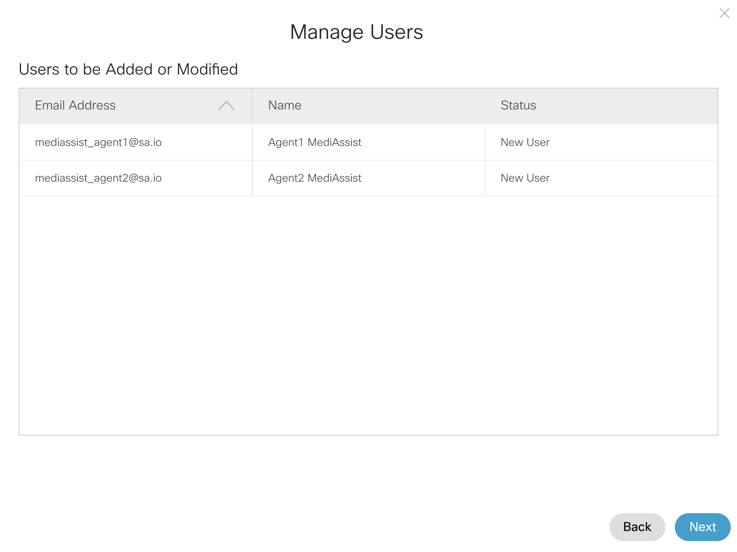
Step5: Admin will get the below message to verify the Name and email address of the new users.
example

Slide 15
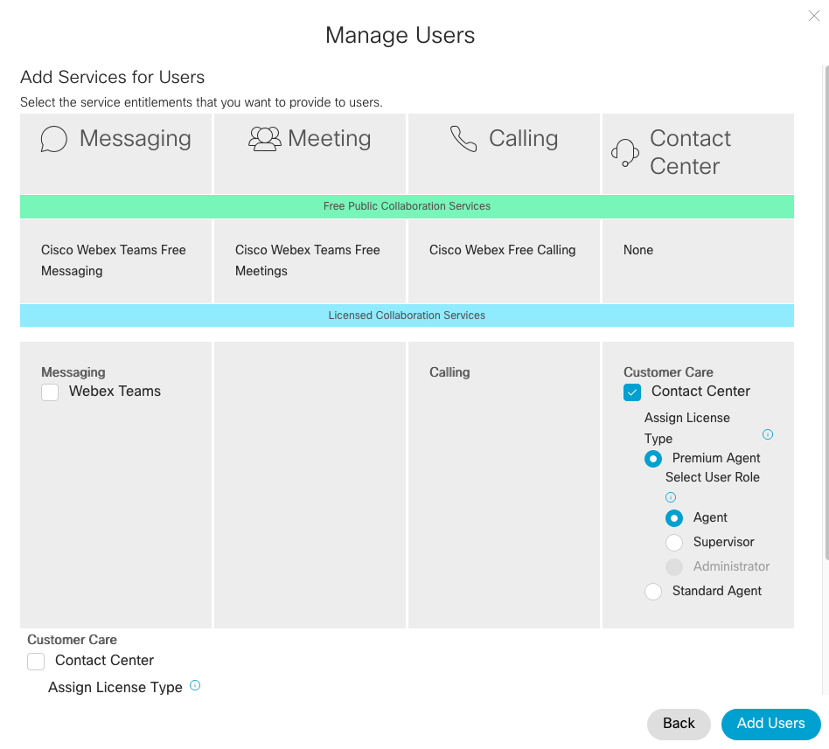
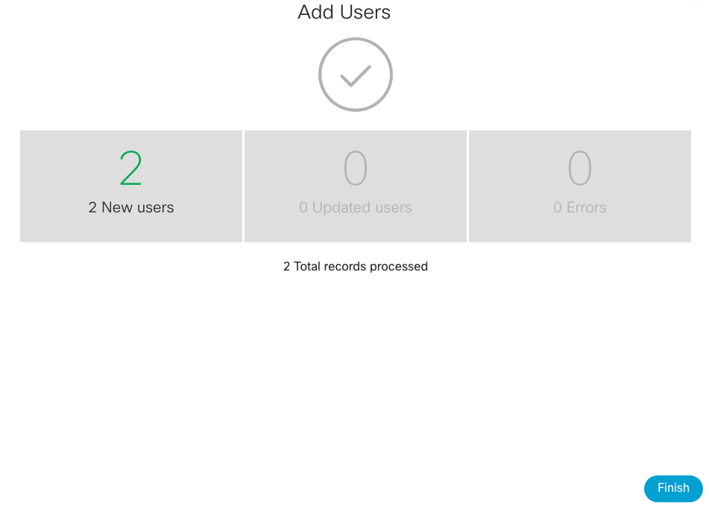
Step6: On this page Admin will assign the Webex CC Licenses as per the design. For example in below screenshot the both the Agents are assigned for Premium Agent Licenses and the Contact center flag is enabled for them. The user role is selected as Agent in the below example. Once done click on Add Users and the system will show the completion confirmation.

Slide 16
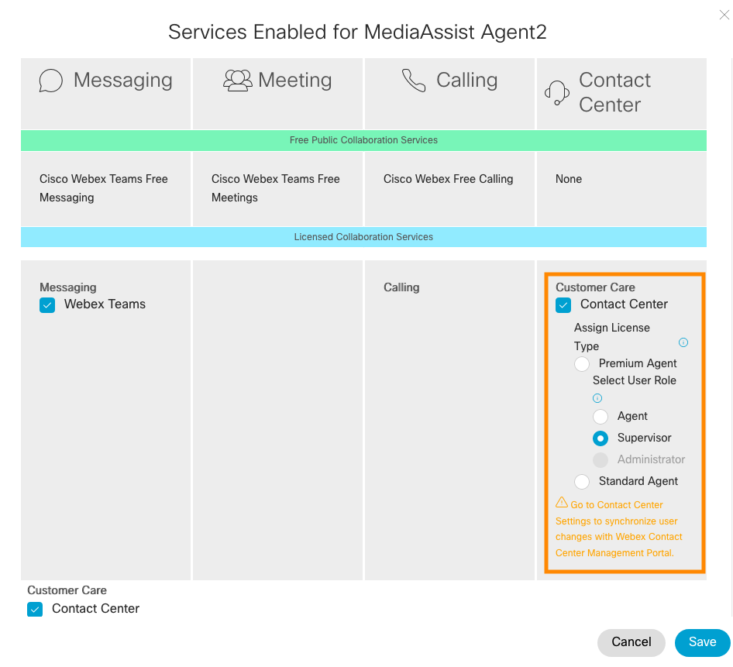
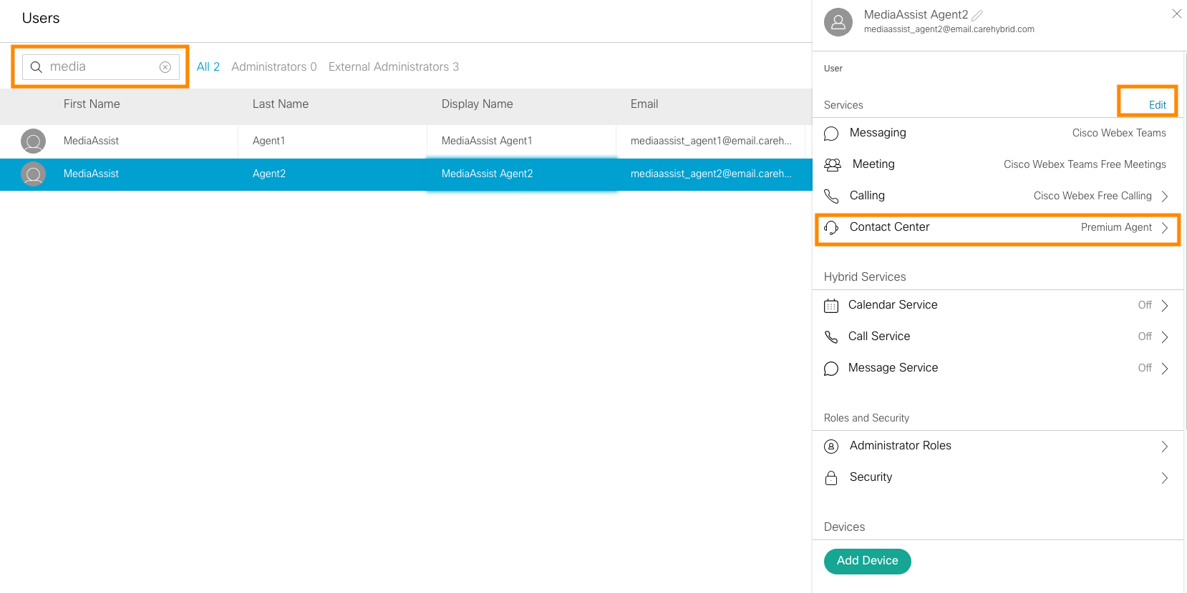
Step7: In order to modify the role of the existing users, admin need to click on the user and the card will come up from the left of the control Hub. In the sample below we can see the current Role of the user is Premium Agent. Click on the Edit button and Admin can modify the roles to Standard Agent or Supervisor as per the business requirement.

Slide 17
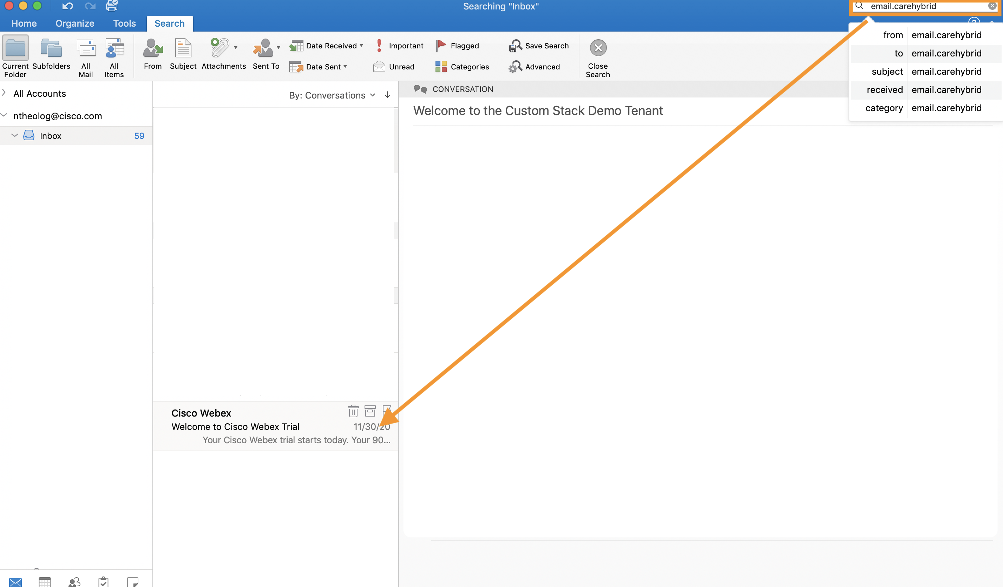
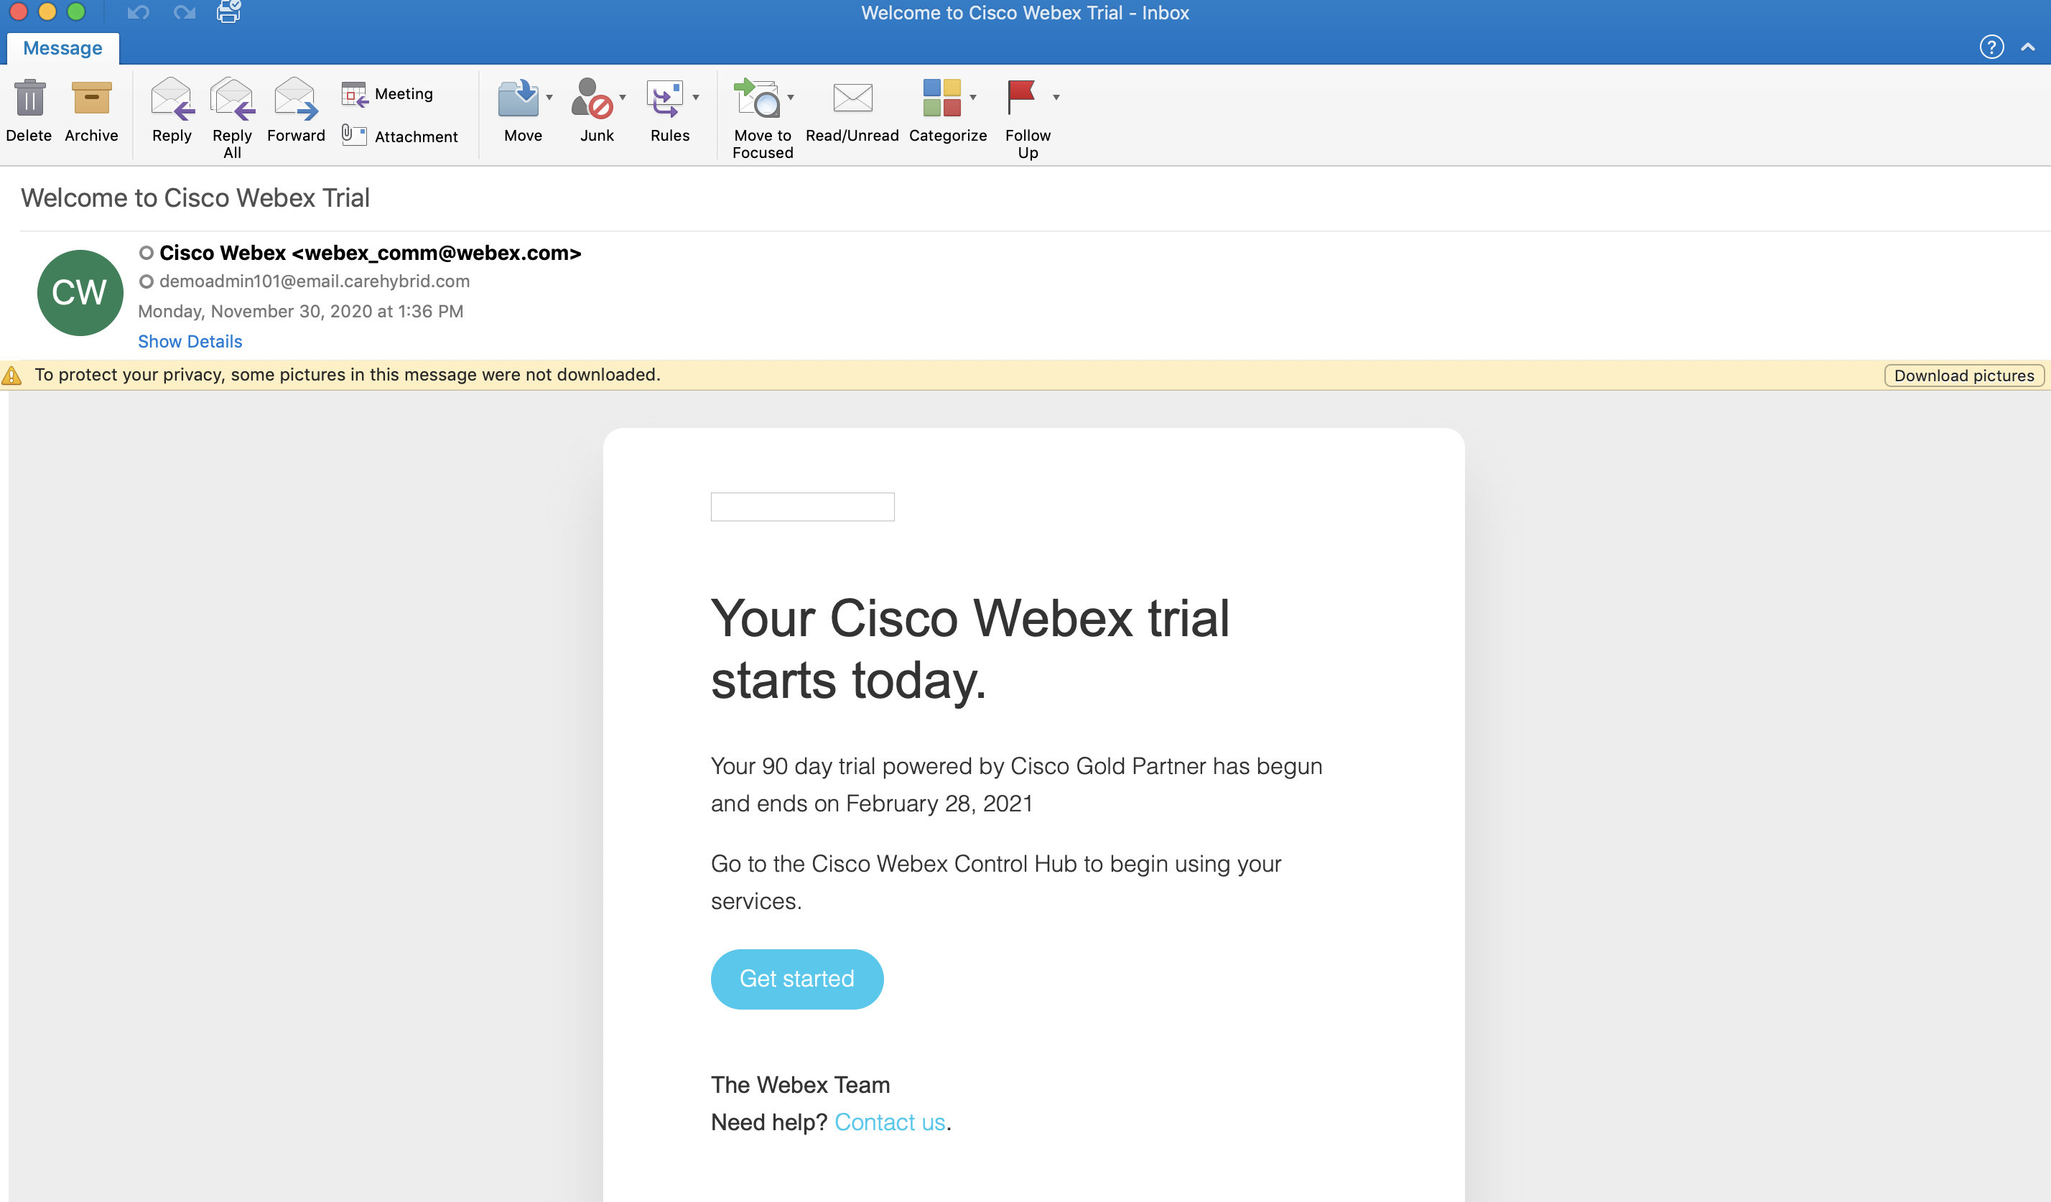
Step8: Before we can sync the user(s) from Control Hub to the Portal, we need the user to accept the email invite, in this case its you. The <username>_agent1@email.carehybrid.com. This is just an alias that points to your real Cisco email. So go to your email client and look for the invite and complete the process. If you don’t see the email… do a general search on your inbox for either: email.carehybrid or webex_comm@webex.com
Inbox
email

Slide 18
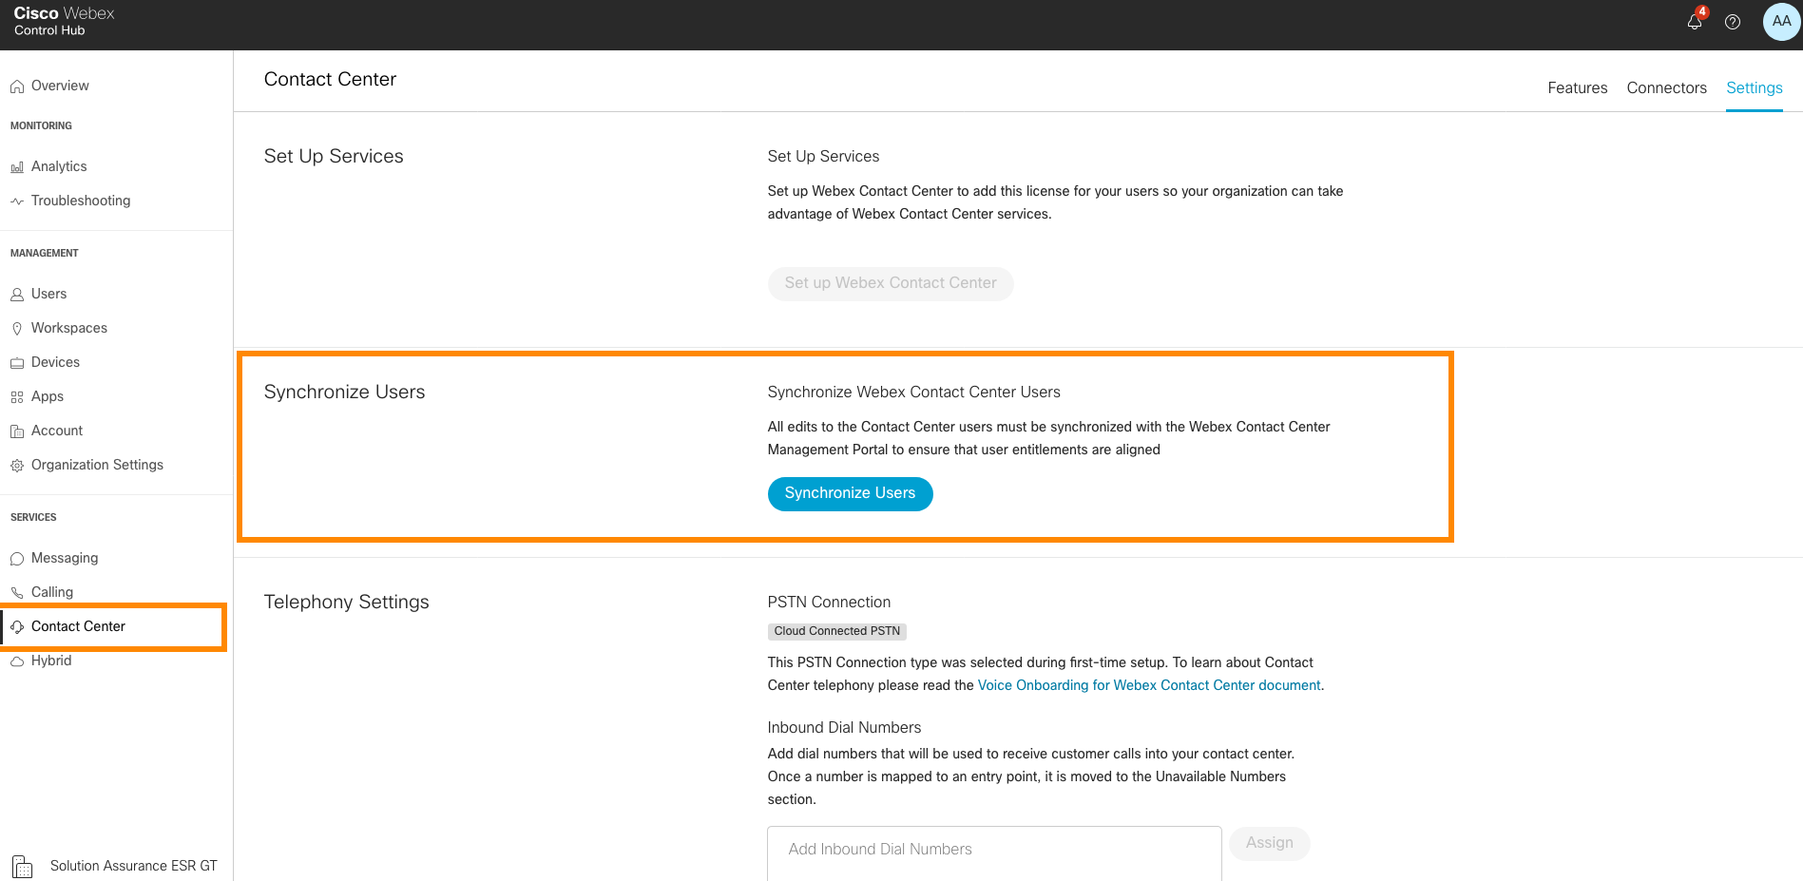
Step10: Users will automatically synchronize from Control Hub to the Cisco WebEx CC Portal. In order to synchronize the users manually from Control Hub to Cisco Webex Contact center portal, this can be achieved from the Contact Center "Settings" option as shown below.

Slide 19
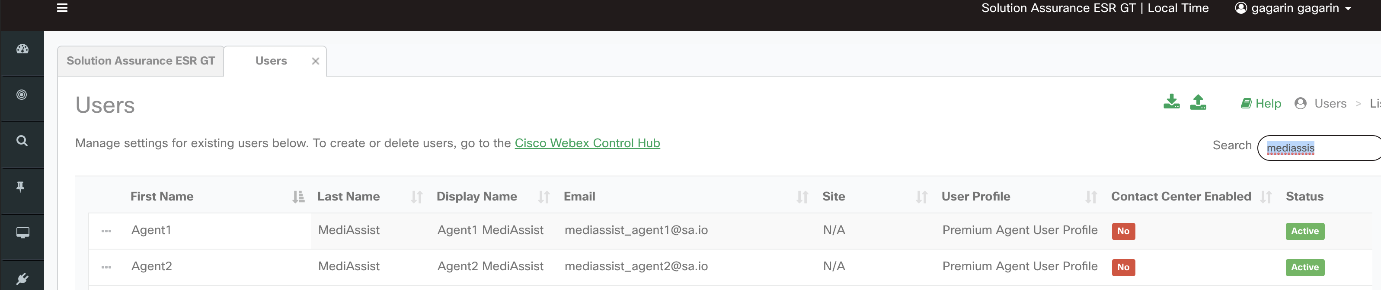
Step11: Cross Launch or Login to Cisco Webex Contact center Portal page and Navigate to users. Administrator should see the newly added users in the Portal user page and the contact center feature should be disabled for the newly onboarded users.

Slide 20
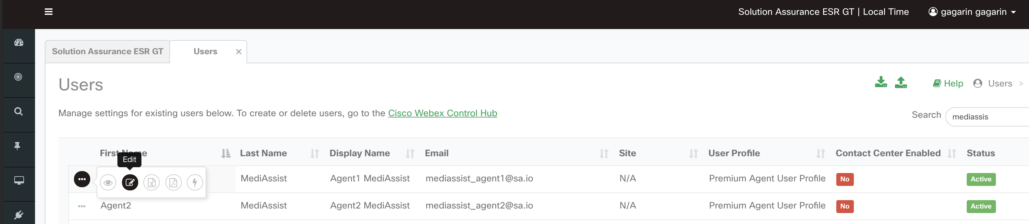
Step12: Edit the users to enable the Contact center feature and assign respective configurations. The configurations shown below are the sample ones. The Administrator needs to assign the desired configuration depending upon the business requirements.

Slide 21
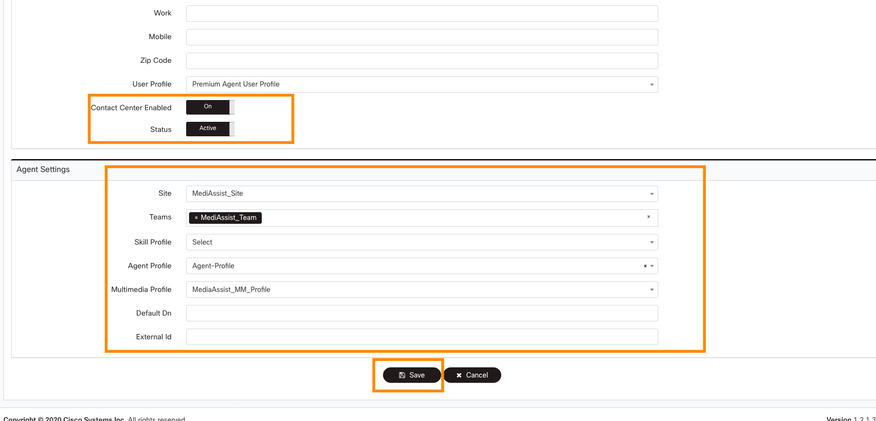
Step10: Cont..
3
* make sure to select a team and a Multimedia profile otherwise you won't be able to login to the Desktop

Slide 22
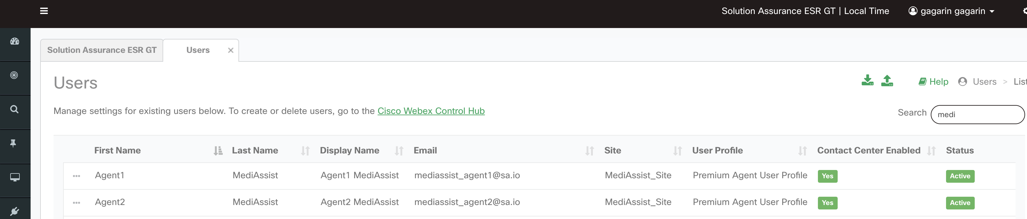
Step14: Once the configurations are saved, the newly added users will be enabled for Contact center and the status will be shown as below. Now the users (Agents) can be logged into the Agent Desktop and will be ready for contact center operations.

Slide 23
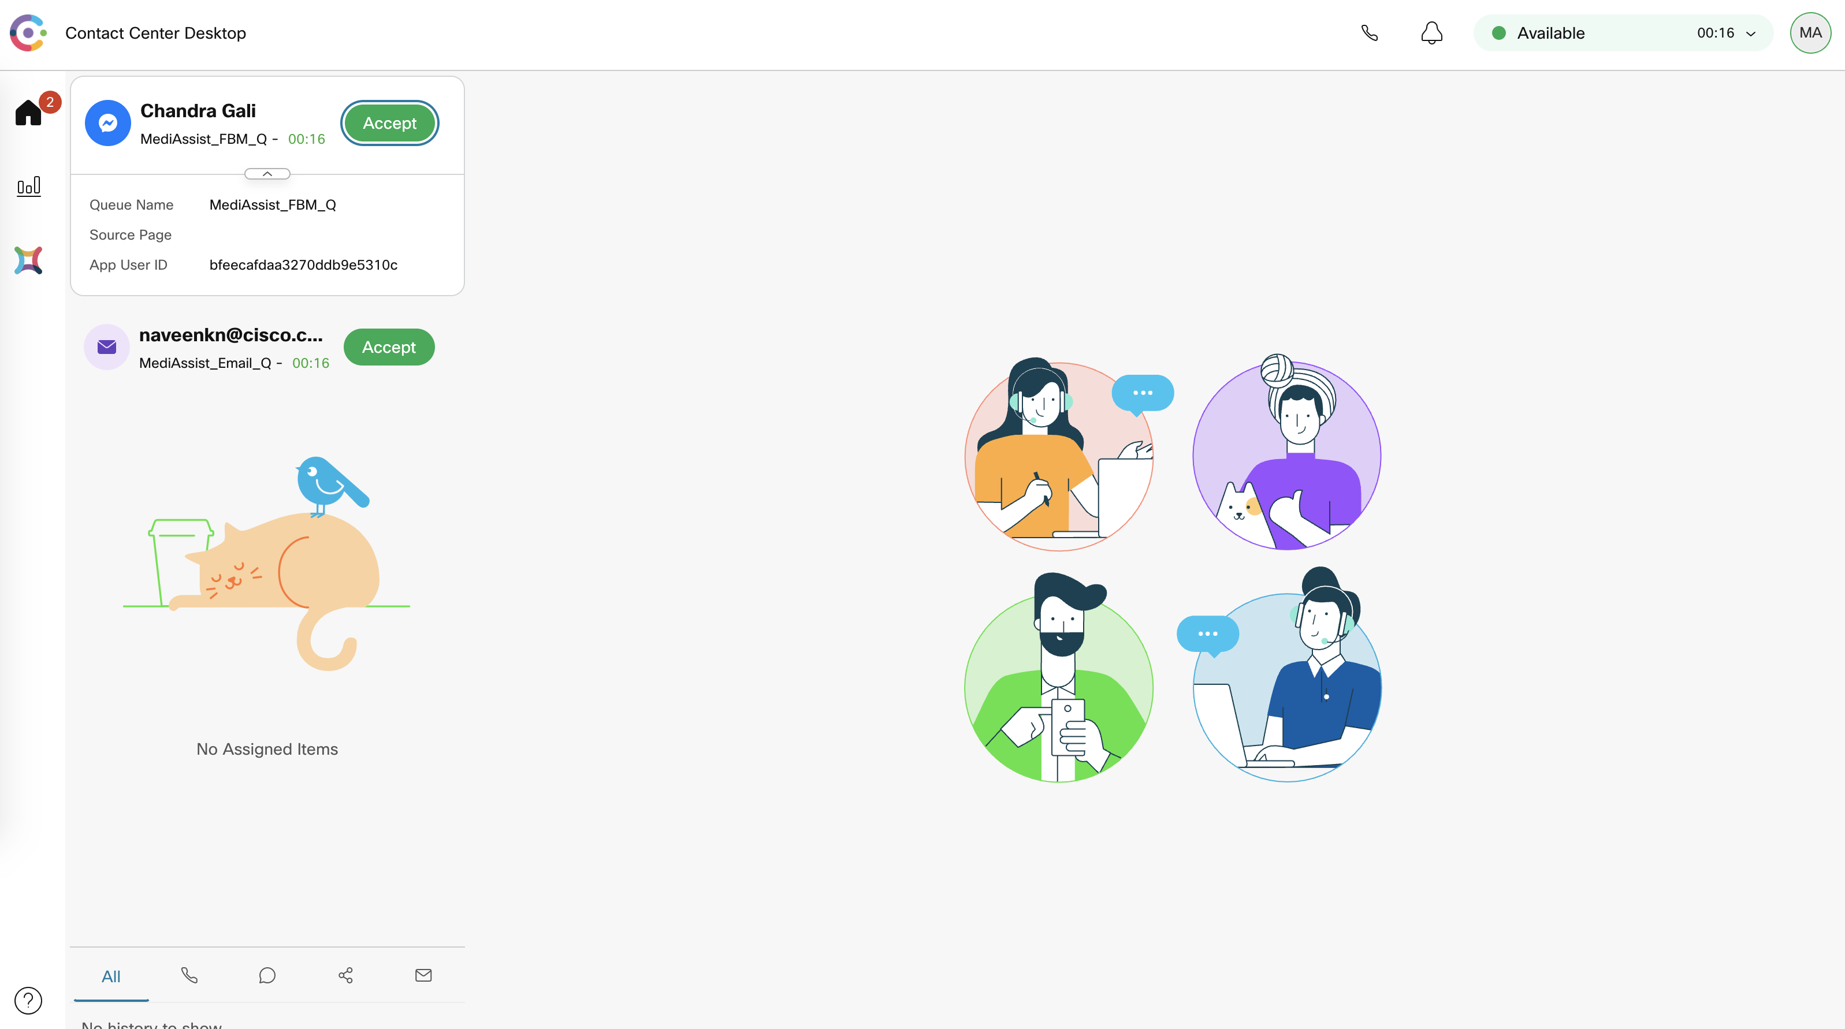
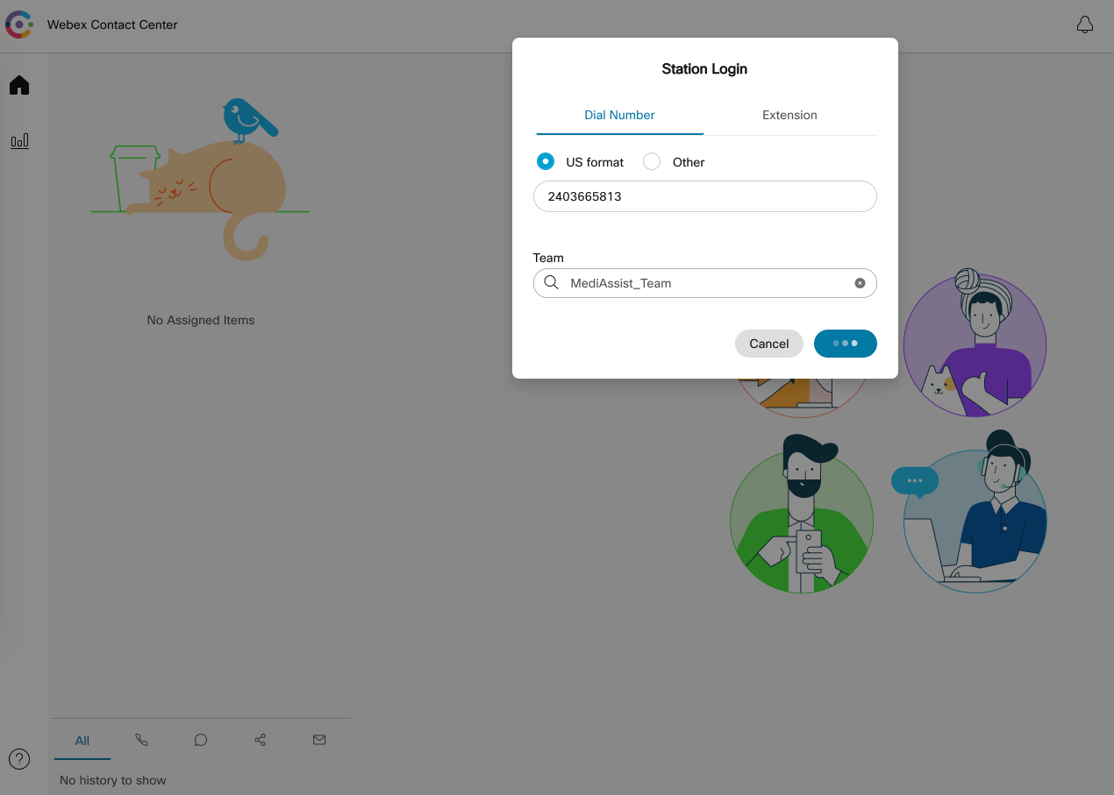
Step15: Login to the Agent Desktop and this completes the user onboarding.

Slide 24
Summary: Module-1 covers the manual addition of new users in Control Hub as Agent/Supervisor and the basic configuration required to enable the user as a Contact center Agent or Supervisor.
Verify Below points Post Module 1:
•Newly added users are showing as "Active" in Control Hub.
•The user's role is assigned as per business requirement (Premium Agents/Standard Agents/Supervisor). This can be verified from the Control Hub Card as well as Webex CC Portal.
•Post synchronization from the Control Hub users are replicated in the Cisco WebEx Contact Center Portal Page with the desired role.
•The contact center feature is enabled for the Users post configuration.
•Users that are assigned as a contact center Agent role can login to Agent Desktop and enabled for assigned multimedia channel.
If new tenant setup – make sure to click "Set up Webex Contact Center" button located in Control Hub -> Contact Center -> Features
Please proceed to Module-2 to continue the configuration

